Slide 1

FinCoreX – Mini Core Banking Application
Streamlined digital banking for modern financial needs
Notes:
AI-generated content may be incorrect. ---

Slide 2
System Overview and Scope
Notes:
What is FinCoreX and Its Purpose, Supported Banking Modules, High-Level Architecture Approach

Slide 3

What is FinCoreX and Its Purpose
Core Banking Functionalities
FinCoreX simulates real-world banking operations like account management, lending, deposits, and interest processing.
Modular and Scalable Design
The system uses a modular, scalable architecture with layered design and event-driven patterns for flexibility.
Configurability and Multi-Currency Support
FinCoreX allows configurable banking behavior and supports multi-currency transactions with exchange rate handling.
Security and API Integration
The application uses JWT authentication, role-based authorization, and offers over 50 REST APIs for integration.
Notes:
FinCoreX is a mini core banking application designed to demonstrate end-to-end banking operations in a modular, scalable, and secure manner. The primary goal of the system is to simulate real-world core banking functionalities such as account management, lending, deposits, interest processing, and end-of-day operations. It is built to closely resemble enterprise banking systems while remaining lightweight enough for rapid development, testing, and demonstration purposes. The application exposes more than 50 REST APIs that enable the creation and management of banks, branches, customers, products, sub-products, currencies, and accounts. A key design focus of FinCoreX is configurability, allowing banking behavior to be controlled through master data rather than hardcoded logic. The system also supports multi-currency transactions by integrating exchange rate handling, which is essential for foreign banking scenarios. From an architectural perspective, FinCoreX follows clean separation of concerns using layered architecture, event-driven patterns, and batch processing where required. It is secured using JWT-based authentication with strict role-based authorization to reflect real banking security standards. Overall, FinCoreX serves as a strong example of how core banking concepts can be implemented using modern Spring Boot technologies while addressing scalability, data consistency, and operational reliability.

Slide 4
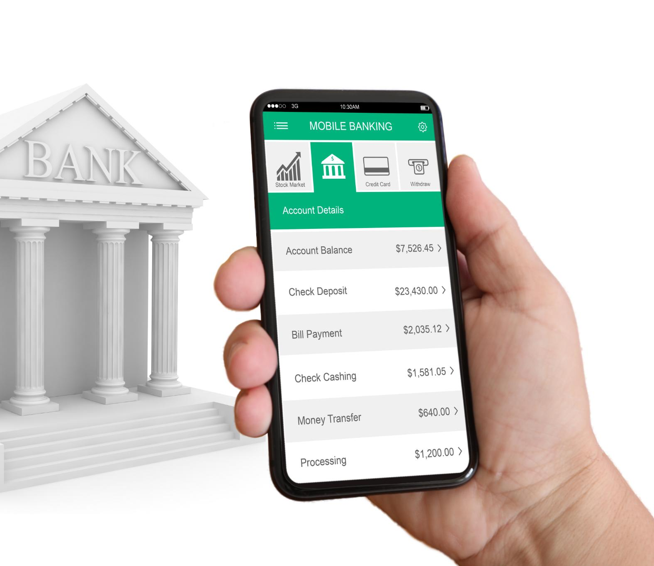
Supported Banking Modules
CASA Module
Supports current and savings accounts with transactions, interest accrual, and balance management.
Lending Module
Manages loan lifecycle including establishment, repayment, collections, arrear processing, delinquency marking and early settlements.
Fixed Deposit Module
Handles FD creation, maturity, interest posting, and automatic closure upon maturity.
Internal Accounts & Integration
Internal accounts ensure accurate financial entries; modules integrate seamlessly for extensibility.
Notes:
FinCoreX consists of three major functional banking modules: CASA, Lending, and Fixed Deposits, along with supporting internal accounts. CASA covers both Current and Savings accounts and supports customer transactions, interest accrual for savings, and balance management. The Lending module handles loan lifecycle management, including loan establishment, repayment scheduling, collections, arrears, delinquency tracking, reversals, and early settlement. The Fixed Deposit module manages FD creation, maturity handling, interest posting, and automatic closure on maturity. Internal accounts, such as GL and Profit & Loss accounts, are used to record accounting entries for interest accruals and applications, ensuring financial correctness. Each module is designed to be independent yet well-integrated with others through shared services and events. This modular structure allows easy enhancement, such as introducing new account types or components without disturbing existing logic. The application also supports foreign currency transactions by associating sub-products with currencies and applying exchange rates wherever applicable. Together, these modules provide a comprehensive mini core banking ecosystem suitable for enterprise-level demonstrations and interviews.

Slide 5
High-Level Architecture Approach
Core Framework and APIs
FinCoreX uses Spring Boot as its core framework, exposing RESTful APIs for all business operations to ensure scalability.
Separation of Concerns
Spring AOP separates business logic from cross-cutting concerns like logging and monitoring to maintain clean code.
Event-Driven Architecture
Spring Application Events enable asynchronous processing for activities like email notifications and interest tracking.
Batch and Scheduling Systems
Spring Batch with multi-threading handles heavy batch operations, while Spring Scheduler manages time-based tasks with dedicated executors.
Data Persistence and Integrity
PostgreSQL and Hibernate with optimistic locking ensure reliable data persistence and prevent inconsistencies.
Notes:
The architecture of FinCoreX is designed with scalability, maintainability, and reliability in mind. It is built using Spring Boot as the core framework, exposing RESTful APIs for all business operations. Business logic is cleanly separated from cross-cutting concerns using Spring AOP, which handles logging and monitoring without polluting core code. Event-driven architecture is implemented using Spring Application Events to asynchronously process activities such as email notifications and interest tracking. Batch-heavy operations like end-of-day processing are handled using Spring Batch with partitioning and multi-threading to ensure performance and concurrency safety. Scheduling requirements, such as business date changes and FD maturity processing, are implemented using Spring Scheduler with dedicated task executors. Data persistence is managed using PostgreSQL and Hibernate with optimistic locking to prevent data inconsistency. This architecture closely mirrors real-world banking systems and demonstrates strong engineering discipline.

Slide 6
Customer, Bank, and Product Setup
Notes:
Bank and Branch Management, Customer Onboarding Process, Abstract Product and Sub-Product Design

Slide 7

Bank and Branch Management
Hierarchical Bank Structure
One head office branch governs multiple regular branches, ensuring centralized control and standard governance.
Branch-Level Operations
Each branch manages customers and accounts, enabling localized account opening and customer onboarding.
Scalability and Control
Explicit branch modeling supports scalability, operational controls, and branch-wise reporting for future enhancements.
Notes:
FinCoreX supports the creation and management of a single bank with multiple branches, closely reflecting a real banking organizational structure. Within this setup, only one branch can be configured as the head office, while the remaining branches operate as regular branches. This constraint ensures centralized control and aligns with standard banking governance models. Each branch can be associated with customers and accounts, enabling branch-level operations and reporting. The branch setup plays a critical role in account opening, customer onboarding, and operational workflows. By modeling banks and branches explicitly, the system lays a strong foundation for scalability and future enhancements such as branch-wise limits, reporting, or operational controls. This design demonstrates an understanding of real banking hierarchies and ensures that core banking data is logically organized and manageable.

Slide 8
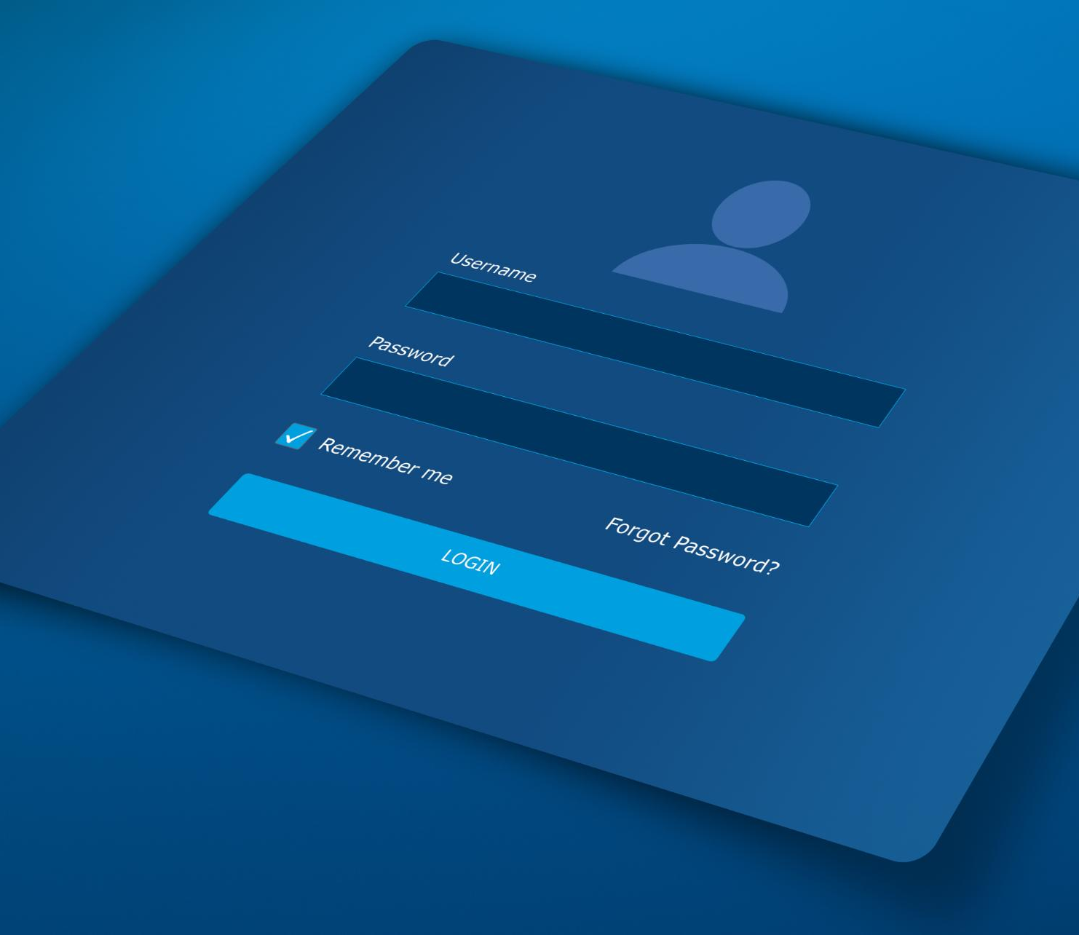
Customer Onboarding Process
Essential Customer Data Capture
Collecting fundamental customer details ensures a solid foundation for banking relationships and compliance.
Efficient Onboarding Workflow
The onboarding flow is minimal and efficient, focusing on data validation and consistency for smooth processing.
Centralized Customer Information
Centralizing customer data supports management of multiple accounts across products and currencies efficiently.
Maintainability and Extensibility
Separation between customer and account data enhances system maintainability and future extensibility.
Notes:
Customer onboarding in FinCoreX is designed to be simple, structured, and compliant with basic banking requirements. To onboard a customer, essential details such as customer name, email address, mobile number, gender, date of birth, and residential address are captured. These details form the foundation for all future banking relationships, including account opening and transaction processing. The onboarding process ensures data validation and consistency while keeping the flow minimal and efficient. Once onboarded, a customer can hold multiple accounts across different products and currencies. This approach reflects real-world banking systems where customer information is centralized and reused across services. The clean separation between customer data and account data also ensures better maintainability and extensibility of the system.

Slide 9

Abstract Product and Sub-Product Design
Two-Level Product Structure
FinCoreX employs a two-level design with Abstract Products as parent categories and Sub-Products as specific variants.
Currency and Variant Specificity
Sub-Products represent currency-specific or variant-specific offerings, providing flexibility in product configurations.
Configurability and Flexibility
Accounts open under sub-products enable banks to add offerings without changing core application logic.
Enterprise Core Banking Alignment
The design reflects enterprise banking systems and showcases strong domain modeling capabilities in FinCoreX.
Notes:
FinCoreX uses a powerful two-level product design consisting of Abstract Products and Sub-Products. Abstract Products represent the parent product category, such as Home Loan, Personal Loan, or Super Savings. Sub-Products are created under abstract products and usually represent currency-specific or variant-specific offerings, such as Home Loan – INR or Home Loan – USD. Accounts are always opened under sub-products, ensuring flexibility and configurability. This design allows banks to introduce new offerings without changing application logic, simply by creating new product configurations. Product types supported include CASA, Loan, Fixed Deposit, and Internal products. This abstraction is a key strength of FinCoreX, as it closely resembles enterprise core banking systems and highlights strong domain modeling skills.

Slide 10
Account and Loan Lifecycle
Notes:
Account Opening and Notifications, Loan Establishment and Scheduling, Repayment Collection Logic

Slide 11

Account Opening and Notifications
Event-Driven Account Opening
Account creation triggers events decoupling business logic from notification services for efficient processing.
Email Notification System
Email notifications are sent asynchronously using Java Mail Sender and Mime Message to customers upon account creation.
Improved System Performance
Asynchronous email handling enhances performance by preventing delays in the core account opening flow.
Notes:
Account opening in FinCoreX is performed under a selected sub-product and associated with a customer and branch. During account creation, the system triggers an email notification to the customer using an event-driven approach. Spring Application Events are published during account opening, and a separate listener consumes the event to send an email using Java Mail Sender and Mime Message. This asynchronous approach ensures that the core account opening flow is not blocked by external operations like email delivery. It also improves system performance and reliability. This design clearly demonstrates best practices in decoupling business logic from auxiliary services and showcases practical use of event-driven architecture in a banking context.

Slide 12

Loan Establishment and Scheduling
Loan Account Setup
Loan accounts link to customers’ settlement accounts to facilitate repayment processing efficiently.
FPI Auto-Generated Loans
FPI loans have auto-calculated interest distributed evenly across repayments based on principal balance.
Manual Schedule Loans
Manual loans allow predefined interest amounts and installment splits, catering to foreign banking needs.
Early Loan Settlement
The loan lifecycle supports early settlement, enabling customers to close loans before maturity.
Notes:
Loan accounts in FinCoreX are established by linking a customer’s settlement account, which is used for repayments. The system supports two repayment schedule types: FPI (auto-generated) loans and Manual Schedule loans. In FPI loans, interest is automatically calculated and distributed across repayments based on the outstanding principal. Manual schedule loans are designed primarily for foreign banks, where interest amounts are predefined and split across installments. This dual approach highlights the system’s flexibility in supporting different banking practices. The loan lifecycle also supports early settlement, allowing customers to close loans before maturity. These features demonstrate strong understanding of lending domain complexities and real-world banking requirements.

Slide 13

Repayment Collection Logic
Collection Order Types
Two types of collection orders exist: Horizontal processes repayments by installment; Vertical prioritizes principal first.
Dynamic Component Attachment
Components can be dynamically added to collection orders for enhanced flexibility and future extensibility.
Repayment Reversals and Blocking
The system supports repayment reversals and applies blocking on settlement accounts based on unpaid repayments and look-ahead days.
Notes:
Repayment collection in FinCoreX is driven by configurable collection orders, which define the priority of components such as principal and interest. Two collection order types are supported: Horizontal and Vertical. Horizontal collection processes principal and interest repayment installment by installment, while Vertical collection prioritizes principal across installments first, followed by interest. The system allows components to be dynamically attached to collection orders, enabling future extensibility. Repayment reversals are also supported, ensuring transaction corrections can be handled safely. Additionally, blocking is applied on settlement accounts based on look-ahead days and unpaid repayments. This robust collection design reflects real-world loan servicing systems and emphasizes configurability and correctness.

Slide 14
EOD, Interest, and Deposits
Notes:
End of Day Processing, Interest Accrual and Application, Fixed Deposit Lifecycle

Slide 15

End of Day Processing
Multi-threaded Batch Jobs
EOD processes run in a multi-threaded environment with partitioning to efficiently handle large data volumes and avoid concurrency conflicts.
Core EOD Processes
Key processes include repayment collection, arrears marking, delinquency processing, interest accrual, and interest application to ensure financial accuracy.
Delinquency Management
Arrears marking and delinquency stages are assigned based on configured profiles, improving accuracy in credit risk management.
Scalable Backend Framework
The EOD framework exemplifies scalable enterprise-level batch processing supporting large financial systems with reliability.
Notes:
FinCoreX implements multiple End of Day (EOD) processes using Spring Batch to handle large volumes of data efficiently. These batch jobs run in a multi-threaded environment with partitioning to prevent concurrency issues. Key EOD processes include repayment collection, arrears marking, delinquency processing, interest accrual, and interest application. Arrears are marked when scheduled payments are missed, and delinquency stages are assigned based on delinquency profiles configured at the sub-product level. This EOD framework demonstrates enterprise-level batch processing capabilities and highlights experience with scalable backend systems.

Slide 16

Interest Accrual and Application
Interest Accrual Types
Credit interest accrual applies to savings and fixed deposits, while debit interest accrual applies to loan accounts.
Accrued Interest Posting
Accrued interest is posted between internal general ledger and profit & loss accounts to maintain accurate records.
Batch Failure Handling
System calculates accrued interest on the fly during account enquiry if batch processing fails, ensuring data accuracy.
Interest Application Process
Interest application posts accumulated interest to customer accounts on the application date for financial correctness.
Notes:
Interest processing in FinCoreX is handled through both accrual and application phases. Credit interest accrual applies to Savings and Fixed Deposit accounts, while debit interest accrual applies to Loan accounts. Accrued interest is posted between internal GL and Profit & Loss accounts. In case of batch failure, the system calculates accrued interest on the fly during account enquiry, ensuring accuracy. Interest details are recorded per transaction using application events, and reversals are fully supported. Interest application posts the accumulated interest to customer accounts on the application date. This design ensures financial correctness and resilience.

Slide 17

Fixed Deposit Lifecycle
FD Account Creation
Funds are debited from savings and credited to the fixed deposit account securely.
Interest Accrual Process
Interest on fixed deposits is accrued periodically ensuring accurate earnings.
Automated Maturity Handling
FD maturity is processed automatically using scheduler to reverse funds timely.
Safe Scheduling Practices
Separate task executor prevents excessive threads and memory errors for reliability.
Notes:
Fixed Deposits in FinCoreX are created by debiting funds from the customer’s savings account and crediting the FD account. Interest accrual is handled periodically, and FD maturity is processed automatically using Spring Scheduler. On the maturity date, reversal transactions are posted to move funds back to the customer’s funding account. A separate task executor is used to avoid excessive OS thread creation and OutOfMemory errors. This implementation demonstrates safe scheduling practices and accurate handling of time-bound financial products.

Slide 18
Security, Dates, and Technology
Notes:
Security and Role Management, Business Date Management, Technology Stack and Key Takeaways

Slide 19

Security and Role Management
JWT Authentication
FinCoreX secures REST endpoints with JWT-based authentication to verify user identity efficiently and securely.
Role-Based Authorization
Role-based authorization restricts access by assigning specific permissions to Teller, Auditor, and Operations Officer roles.
Operational Role Separation
Strict separation of roles ensures data security and operational control, mirroring real banking environment practices.
Notes:
All REST endpoints in FinCoreX are secured using Spring Security with JWT-based authentication and role-based authorization. Three primary roles are supported: Teller, Auditor, and Operations Officer. Tellers have read and write access, Auditors have read-only access, and Operations Officers are responsible for executing EOD processes. This strict role separation ensures data security and operational control, closely matching real banking environments. The security design demonstrates strong understanding of enterprise access control mechanisms.

Slide 20

Business Date Management
Business Date Concept
FinCoreX introduces a business date concept to decouple from system dates during lifecycle testing.
API and Scheduler Functionality
A dedicated API enables manual business date changes, while a scheduler increments it automatically at midnight.
Persistence and Lifecycle Integration
Business date is saved to database on shutdown and restored on startup using Spring Bean lifecycle hooks.
Importance for Banking Simulations
This business date management is vital for accurate banking simulations and temporal data handling.
Notes:
FinCoreX introduces a business date concept to avoid reliance on system dates during lifecycle testing. A dedicated API allows manual modification of the business date. Additionally, a scheduler increments the business date automatically at midnight. The business date is persisted to the database during application shutdown and restored on startup using Spring Bean lifecycle hooks. This feature is critical for banking simulations and demonstrates advanced handling of temporal data in enterprise systems.

Slide 21

Technology Stack and Key Takeaways
Spring Framework Components
FinCoreX leverages multiple Spring components including Boot, Security, Batch, Scheduler, AOP, and Application Events for robust backend functionality.
Database and ORM
PostgreSQL is the chosen database with Hibernate ORM enabling efficient data handling and integration.
Optimistic Locking
Optimistic locking using @Version fields helps prevent data inconsistencies in concurrent transactions.
Key Engineering Strengths
FinCoreX showcases backend engineering, banking domain expertise, modularity, scalability, and security for real-world applications.
Notes:
FinCoreX is built using Spring Boot, Spring Security, Spring Batch, Spring Scheduler, Spring AOP, and Application Events. PostgreSQL is used as the database with Hibernate as the ORM framework. Optimistic locking is implemented using @Version fields to prevent data inconsistency. Overall, FinCoreX demonstrates strong backend engineering skills, solid banking domain knowledge, and practical application of enterprise Java technologies. It is modular, scalable, secure, and well-suited for real-world banking use cases as well as technical interviews.

